Slide 1
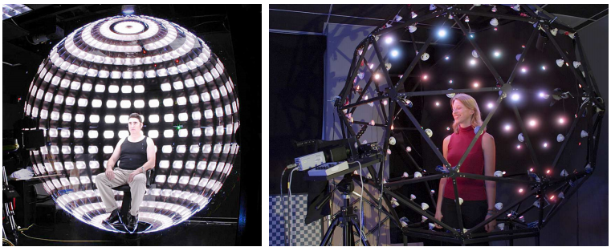
Light Stages Face Caputure 관련 내용을 중심으로
2020 Feb. 서준원
- The Light Stages and Their Applications to Photoreal Digital Actors ,Paul Debevec, 2012

Slide 2
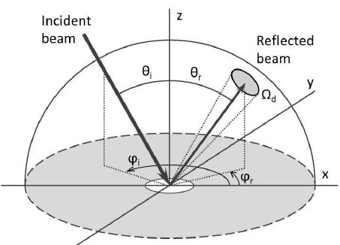
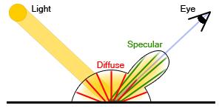
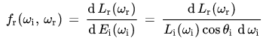
BRDF
Bidirectional Reflectance Distribution Function
Diffuse BRDF
Specular BRDF
four-dimensional bi-directional reflectance distribution function

Slide 3
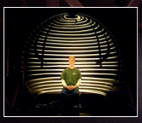
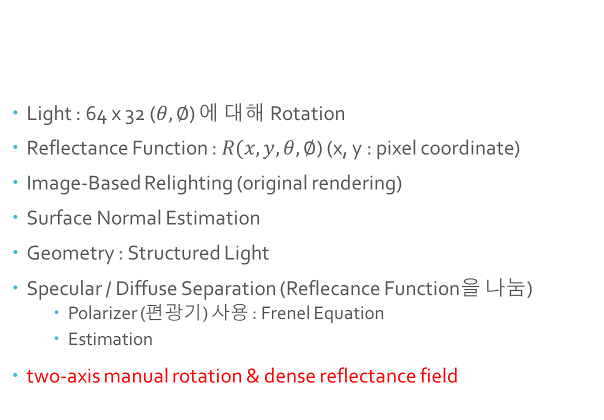

Light Stages 1
- One Camera
- Manual Lamp : 64 divisions of $θ$and 32 divisions of $∅$in one minute
Light : 64 x 32 ($θ,∅$) 에 대해 Rotation
Reflectance Function : $R(x, y, θ,∅$) (x, y : pixel coordinate)
Image-Based Relighting (original rendering)
Surface Normal Estimation
Geometry : Structured Light
Specular / Diffuse Separation (Reflecance Function을 나눔)
Polarizer (편광기) 사용 : Frenel Equation
Estimation
two-axis manual rotation & dense reflectance field
Paul Debevec , 2000. Acquiring the reflectance field of a human face. In Proceedings of ACM SIGGRAPH 2000, 145–156

Slide 4
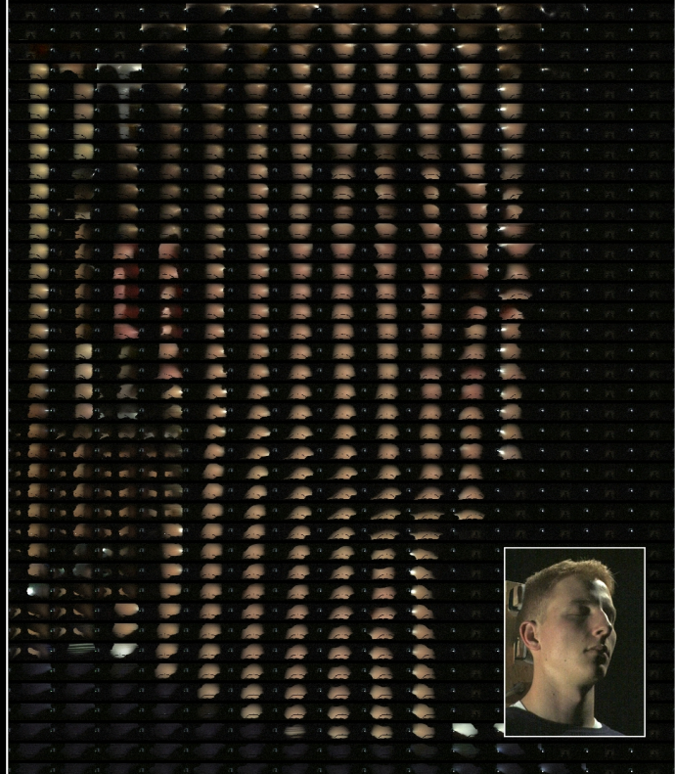
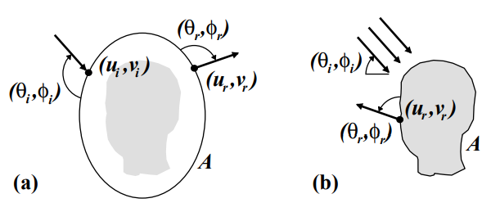
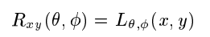
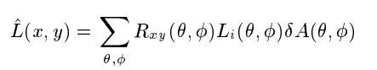
Acquiring the Reflectance Field of a Human Face (Paul Debevec)
Reflectance Field
Reflectance function for
a particular viewpoint
Reflectance Function for a pixel
Re-Illuminating (Relighting)
Paul Debevec , 2000. Acquiring the reflectance field of a human face. In Proceedings of ACM SIGGRAPH 2000, 145–156

Slide 5
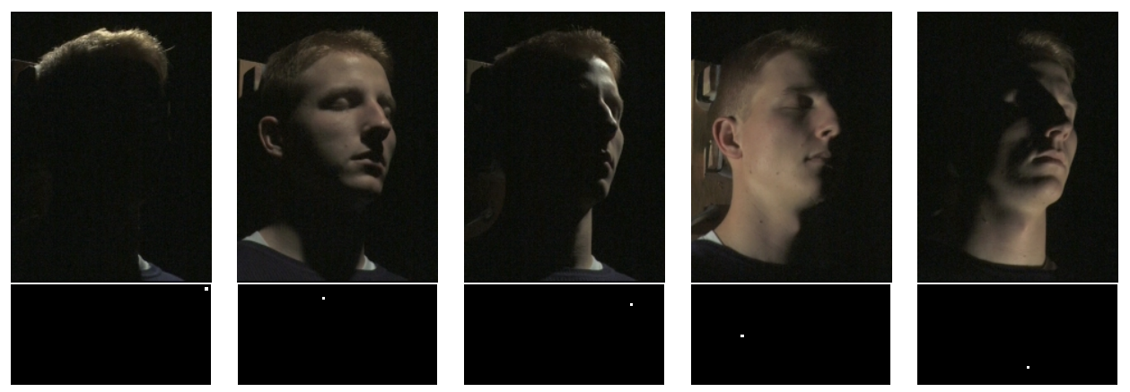
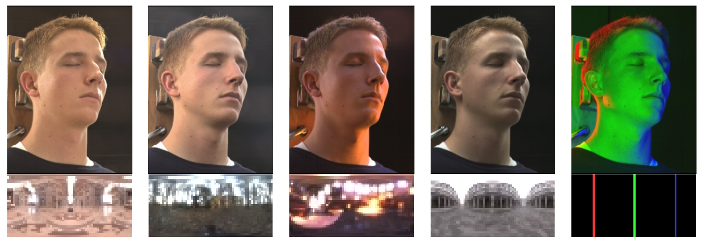
Acquiring the Reflectance Field of a Human Face (Paul Debevec)
Paul Debevec , 2000. Acquiring the reflectance field of a human face. In Proceedings of ACM SIGGRAPH 2000, 145–156

Slide 6
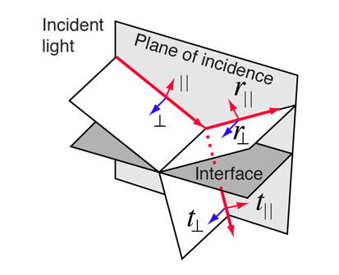
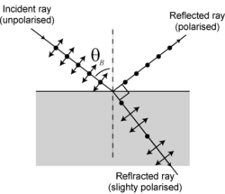
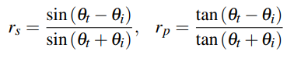
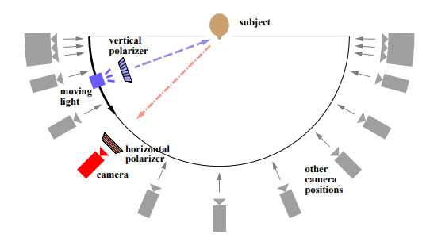
Polarization-Based Analysis of Reflected Light
Frenel Equation
Brewster's angle
Separation Using Linearity
Horizontal(Light) + Vertical(Camera) -> half of the diffusely reflected light (I1 = 0.5 * Diffuse)
Horizontal(Light) + Horizontal(Camera) -> (I2 = 0.5 * Diffuse + Specular )

Slide 7
Skin Reflectance
Diffuse & Specular
Separation using Polarization (Fresnel Equation)
Specular : Incident Ray’s Polarization 유지
Diffuse : Unpolarized
Diffuse reflectance function & Specular reflectance function
Surface Normal & Albedo (estimation : derived from the fitted diffuse reflectance lobe for each pixel)
Circular Polarization (Light source simultaneously)
Multiview 에서 사용
Near the Brewster angle the reflection is weak, making recovery of true specular reflectance unstable
다양한 Polarization Scheme
Fast Capture, Stable Specular Reflection on Spheres
Polarization-Based Analysis of Reflected Light

Slide 8
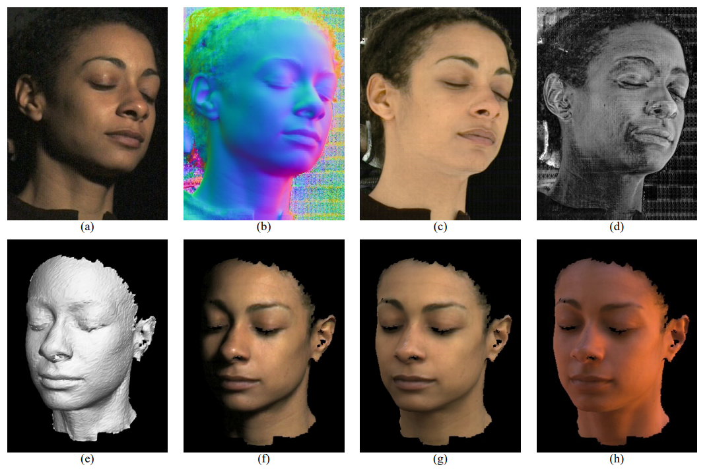
Viewpoint Change (Calibration is pre-computed)
Rendering
Face geometry recovered using structured lighting (With Geometry)
Acquiring the Reflectance Field of a Human Face (Paul Debevec)
Surface Normal
Albedo
Specular Energy
Face Geometry
Rendering under various lighting environments
Paul Debevec , 2000. Acquiring the reflectance field of a human face. In Proceedings of ACM SIGGRAPH 2000, 145–156

Slide 9
Light Stages
Light Stage 2: Faster Capture and Facial Animation
Recording the reflectance of a face faster by including a set of thirty strobe-lights on a semicircular arm in eight seconds.
Light Stage 3: Lighting Reproduction
156 color controllable RGB LED lamps mounted on a geodesic dome of 2m diameter
Light Stage 5: Performance Relighting
156 bright white LED lamps
record an actor’s reflectance dynamically using time-multiplexed illumination and high-speed video
facial geometry and reflectance capture in conjunction with polarized spherical gradient illumination
Light Stage 6: Re-lighting the Whole Body
Light Stage X (LS X)
330 LED light sources, each with many multi-spectral illuminants with fine grained control over spectra, intensity and polarization of incident light
programmable light sources and interchangeable filters
Multiview Capture
DEBEVEC P.: The Light Stages and Their Applications to Photoreal Digital Actors. In SIGGRAPH Asia (Singapore, Nov. 2012)

Slide 10
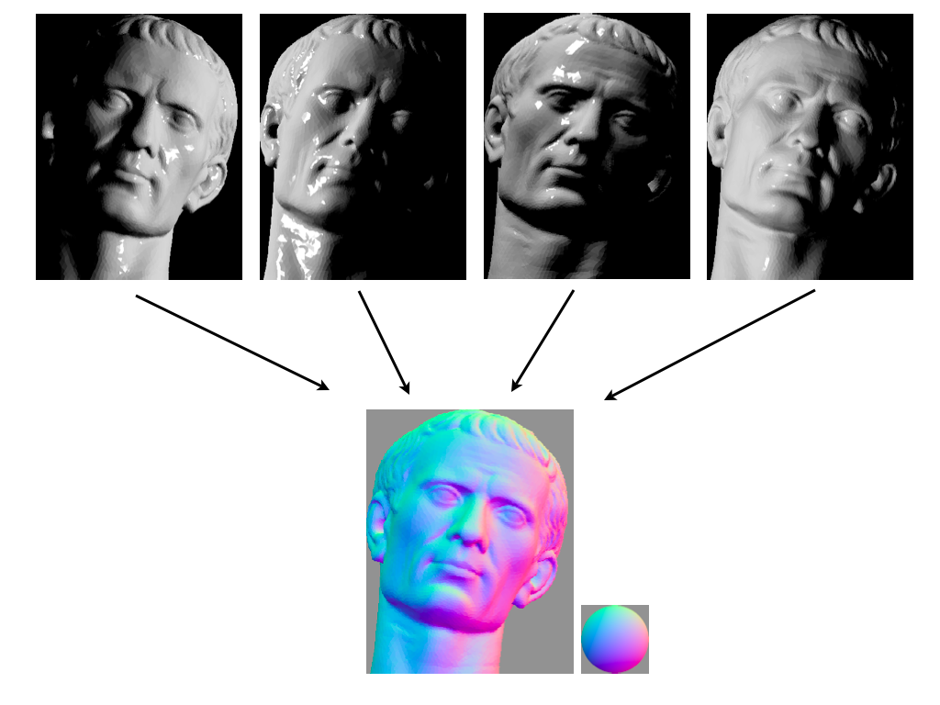
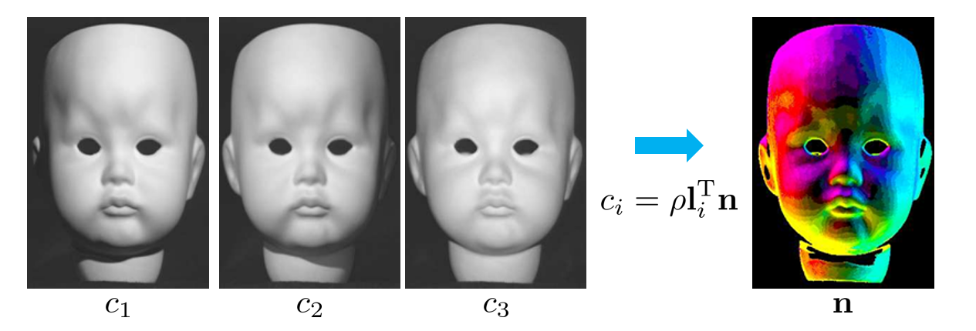
Photometric Stereo
Lambertian surface
multiple illumination directions
Surface Normal
&
Albedo
R. J. Woodham. Photometric method for determining surface orientation from multiple images

Slide 11
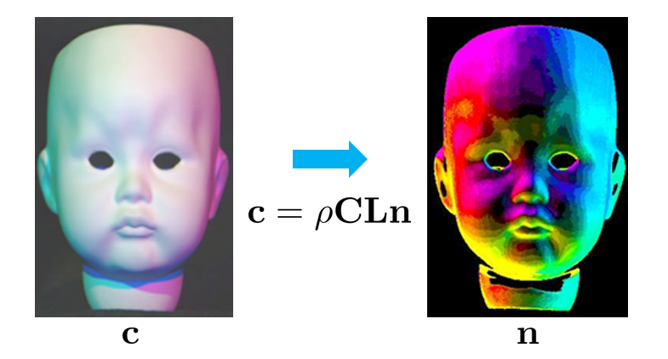
Single-Shot Reflectance Measurement
Taking many images of the object under a dense sampling of lighting directions
requiring either long capture times or specialized high-speed cameras
Three colored lights to perform photometric stereo in a single photograph, which is possible under the constant chromaticity assumption that all scene materials vary only in brightness, and not in hue or saturation
Single-Shot Reflectance Measurement from Polarized Color Gradient Illumination (Graham, Fyffe Paul Debevec)

Slide 12
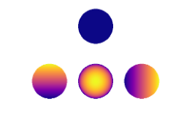
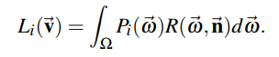
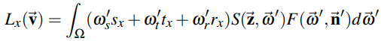
Spherical Harmonics
Digitize facial geometry with sub-millimeter precision :
leveraging the full sphere of LED light sources in Light Stage 5 to create spherical illumination patterns.
Instead of lighting the face one direction at a time, requiring hundreds of photographs to record reflectance functions, reflectance functions would be measured using computational illumination patterns based on the first four spherical harmonics [Ma et al. 2007].
Spherical Harmonics
The total energy of a pixel’s reflectance function : 0'th order spherical harmonic.
The first three 1st order spherical harmonics oriented along the three principal coordinate axes : surface normal, since a Lambertian reflectance lobe is symmetrically oriented along the normal.
Diffuse Normal
Specular Normal
Rapid Acquisition of Specular and Diffuse Normal Maps from Polarized Spherical Gradient Illumination (Wan-Chun Ma, Paul Debevec)

Slide 13
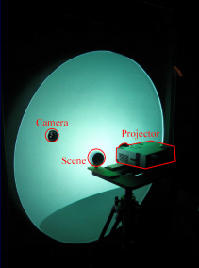
Gradient Illumination Face Scanning
Polarized Spherical Gradient Illumination
Spherical Lighting separate photometric albedo and normal maps for specular (surface) and diffuse (subsurface) reflection by employing polarization of incident lighting.
estimate surface normal maps of an object from either its diffuse or specular reflectance using four spherical gradient illumination patterns
the diffuse and specular normal maps of an object to be measured independently
limits the acquisition to a single viewpoint providing limited coverage of the scanned subject.
Second-order gradients – the next five of the first nine spherical harmonic conditions – allow the estimation of per pixel specular roughness and anisotropy
Reflective hemisphere for highly specular surface
icosahedron
- LED sphere (156 individually controllable lights)
2 SLRs cameras (Burst Mode)
Polarizer over each light (Linear : Servomotor -> flipping / Circular : manual flipping) :
Rapid Acquisition of Specular and Diffuse Normal Maps from Polarized Spherical Gradient Illumination (Wan-Chun Ma, Paul Debevec)

Slide 14
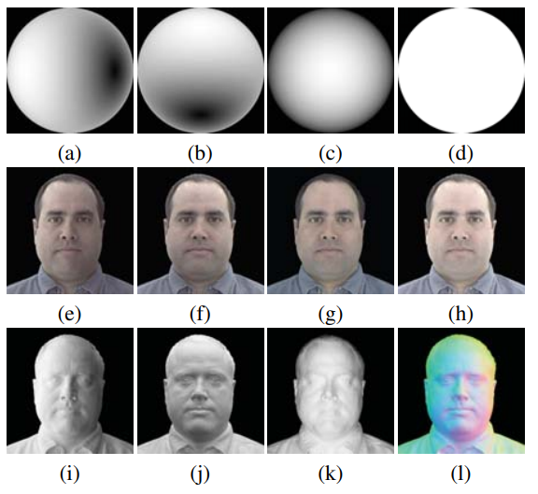
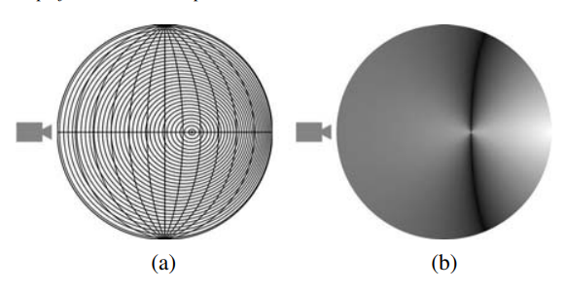
Computing normal from x, y, z
lighting using reflectance function Lambertian Surface Reflection & Specular Surface Reflection.
Gradient Illumination Face Scanning
Near the Brewster angle
the reflection is weak, making recovery of true specular reflectance unstable
Linear / Circular polarizers
Surface Geometry
: structured light scan +surface normal based on the specular reflectance

Slide 15
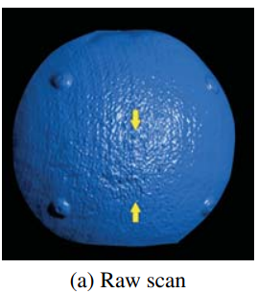
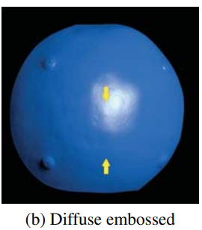
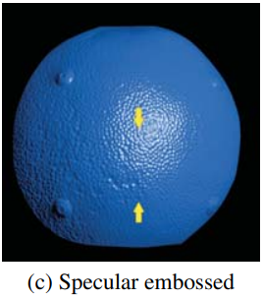
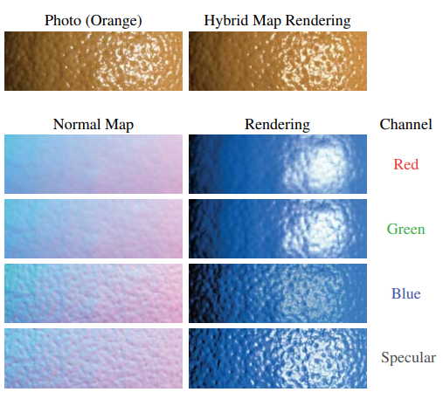
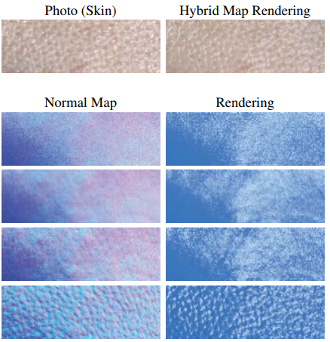
Gradient Illumination Face Scanning
Rapid Acquisition of Specular and Diffuse Normal Maps from Polarized Spherical Gradient Illumination (Wan-Chun Ma, Paul Debevec)

Slide 16
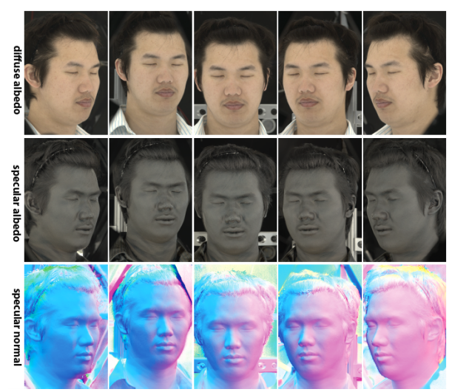
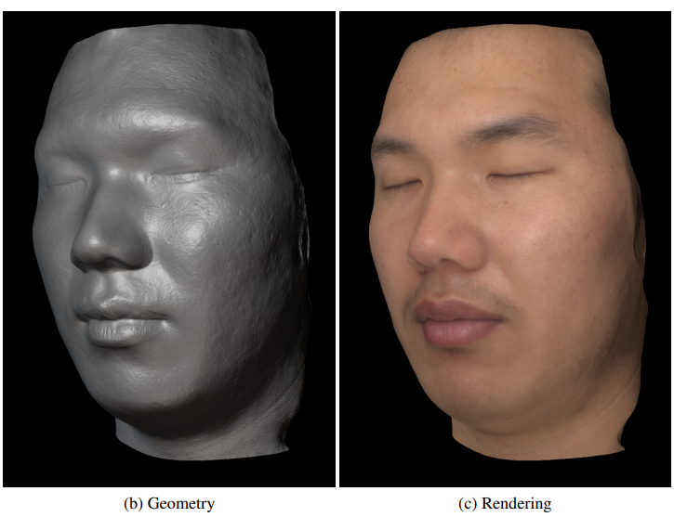
Multiview Capture and Light Stage X
Single View : Three different angles to produce an ear-to-ear facial scan
Multiview Camera Setup (five Canon 1D Mark III digital SLRs camera)
programmable MR16 LED lamps (5W) from Philips Color Kinetics
LED sphere with 156 individually controllable lights
Stereo Reconstruction
- Multiview Face Capture using Polarized Spherical Gradient Illumination (Abhijeet Ghosh, Paul Debevec)
- ICL Multispectral Light Stage: building a versatile LED sphere with off-the-shelf components (Abhijeet Ghosh)

Slide 17
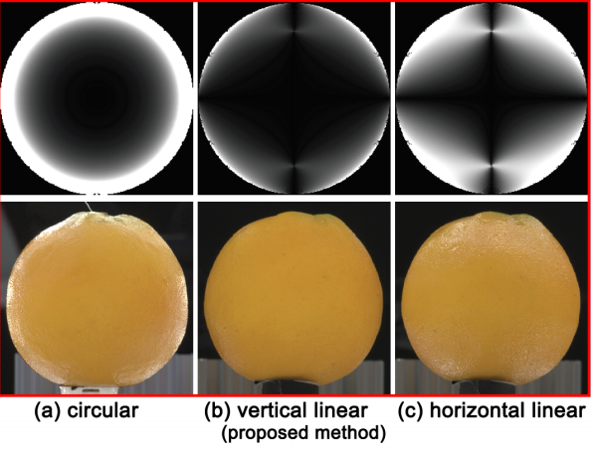
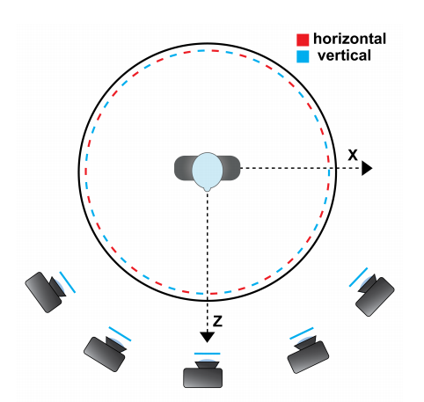
Multiview Capture and Light Stage X
Diffuse-Specular separation from just two photographs
Ghosh et al.’s technique requires four photographs
Latitude-Longitude Linear Polarization
Cameras’ Polarizers : Static Vertical Polarizer
specular cancellation
- Multiview Face Capture using Polarized Spherical Gradient Illumination (Abhijeet Ghosh, Paul Debevec)

Slide 18
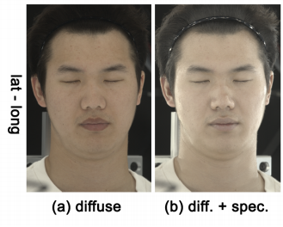
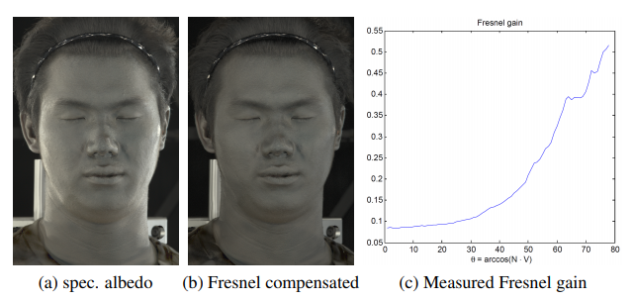
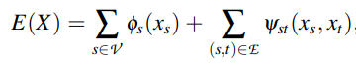
Multiview Capture and Light Stage X
diffuse and specular albedo
& normal maps
from multiple viewpoints
compensate for the Fresnel gain
(to make the specular albedo maps less view-dependent and more suitable for stereo.)
Stereo Reconstruction
(Cost function minimization (no merging))
Hard Reconstruction
- Multiview Face Capture using Polarized Spherical Gradient Illumination (Abhijeet Ghosh, Paul Debevec)

Slide 19
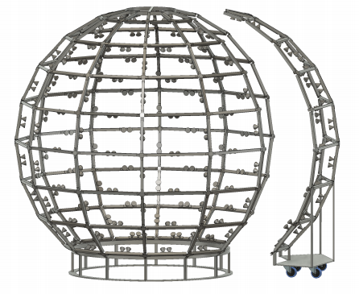
ICL Multispectral Light Stage
Light : 168 RGB and color temperature controllable white (W+) lamps
Philips Color Kinetics iW MR gen3 and iColor MR gen3 lamps
Wire : unlike a typical geodesic (subdivided icosahedron), spherical coordinates with latitude-longitude profiles
12 vertical and 8 horizontal latitudinal connections
Control signals : Ethernet using KiNET, a proprietary lighting protocol from Philips Color Kinetics
Camera
9 Canon 800D DSLR cameras for multiview face capture
Canon 18-135 mm zoom lenses equipped with glass linear polarizers (Hoya)
Point Grey Grasshopper 3 (GS3-U3-41C6C-C) machine vision camera for video rate capture
Synchronization (camera – camera / light – camera) : Raspberry Pi 3B
horizontal and vertical polarizers
Multispectral
ICL Multispectral Light Stage: building a versatile LED sphere with off-the-shelf components (Abhijeet Ghosh)

Slide 20
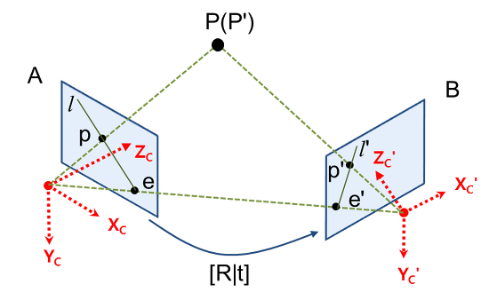
Multi View Stereo (MVS)
Geometry : Consistency를 바탕으로 (여러 이미지에서의 points correspondence) depth를 계산 (Camera Calibration 이용)
SL 방식에 비해 정확도가 떨어지고, 어렵다.
Correspondence를 파악하기 어려움
Surface normal data를 사용해서 minimum cost function 방법으로 접근하기도 함.
Light Stage에서 rendering을 해내기 위해서는 Base Geometry 정보가 필요하다 (embossed with surface normal & albedo)

Slide 21
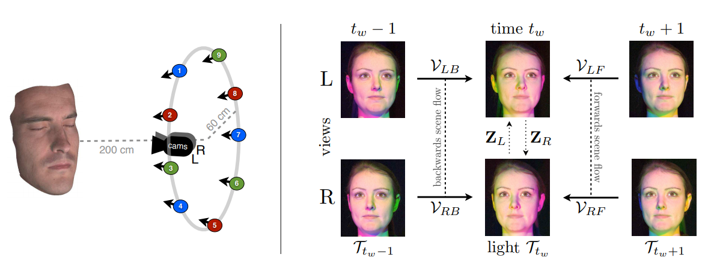
Photometric Sceneflow
Photometric Stereo + Multiview Stereo + Optical Flow
Optical flow : Dynamically changing object
high-quality dynamic 3D reconstruction
Photogeometric Scene Flow for High-Detail Dynamic 3D Reconstruction

Slide 22
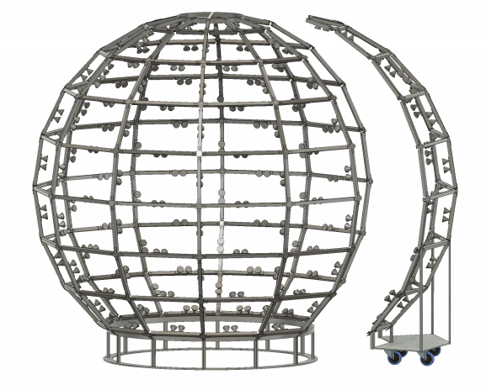
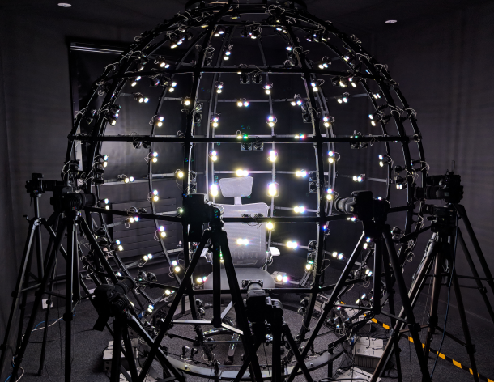
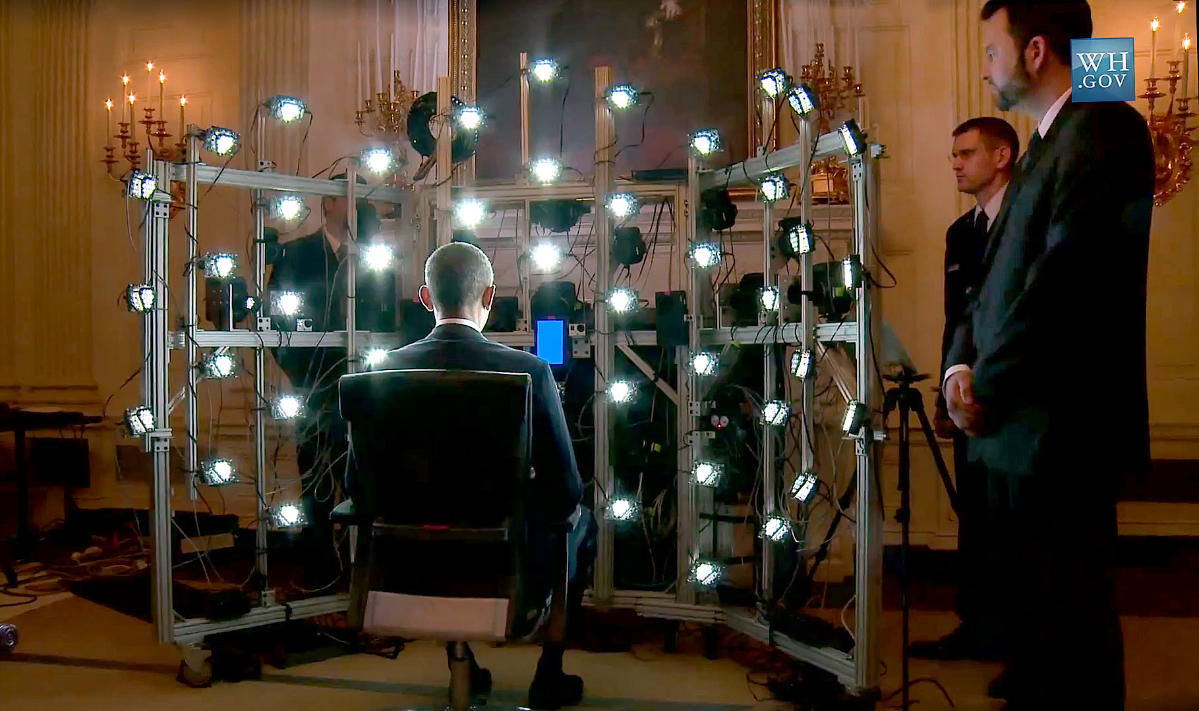
Conclusion
설계 모델
Light (Programmable LED / Multispectral), Camera, Polarizer ?
Multi-view vs Single-view (required scanning from three different angles to produce an ear-to-ear facial scan)
With Structured Light ?
Eyes, Teeth
Structured Light 와 비교
Fancy
Precise Skin & Color Rendering
Surface normal, albedo estimation method?
High Setup cost
Base Geometry
Structured Light, Multi-View
구체적인 Estimation, Rendering method

